Slide 1
Managing Asynchronicity with RQ and JSCheck

Slide 2
Synchronous functions Asynchronous functions

Slide 3
Synchronous functions
Do not return until the work is complete or failed.

Slide 4
The Problems With Threads
Races
Deadlocks
Reliability
Performance

Slide 5
Threading
Pro
Con
No rethinking is necessary.
Blocking programs are ok.
Execution continues as long as any thread is not blocked.
Stack memory per thread.
If two threads use the same memory, a race may occur.

Slide 6
Two threads
my_array[my_array.length] = 'a';
my_array[my_array.length] = 'b';
['a', 'b']
['b', 'a']

Slide 7
Two threads
my_array[my_array.length] = 'a';
my_array[my_array.length] = 'b';
['a', 'b']
['b', 'a']
['a']
['b']

Slide 8
my_array[my_array.length] = 'a';
length_a = my_array.length;
my_array[length_a] = 'a';
if (length_a >= my_array.length) {
my_array.length = length_a + 1;
}

Slide 9
my_array[my_array.length] = 'a'; my_array[my_array.length] = 'b';
length_a = my_array.length;
my_array[length_a] = 'a';
if (length_a >= my_array.length) {
my_array.length = length_a + 1;
}
length_b = my_array.length;
my_array[length_b] = 'b';
if (length_b >= my_array.length) {
my_array.length = length_b + 1;
}

Slide 10
my_array[my_array.length] = 'a'; my_array[my_array.length] = 'b';
length_a = my_array.length;
length_b = my_array.length;
my_array[length_a] = 'a';
if (length_a >= my_array.length) {
my_array[length_b] = 'b';
my_array.length = length_a + 1;
}
if (length_b >= my_array.length) {
my_array.length = length_b + 1;
}

Slide 11
It is impossible to have application integrity when subject to race conditions.

Slide 12
Mutual Exclusion
semaphore
monitor
rendezvous
synchronization
This used to be operating system stuff.
It has leaked into applications because of networking and the multi-core problem.

Slide 13
Mutual Exclusion
Only one thread can be executing on a critical section at a time.
All other threads wanting to execute the critical section are blocked.
If threads don’t interact, then the program runs at full speed.
If they do interact, then races will occur unless mutual exclusion is employed.

Slide 14
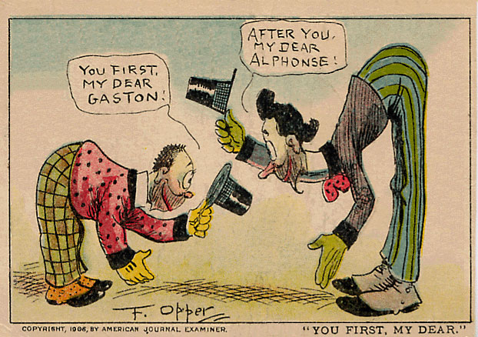
Deadlock

Slide 15
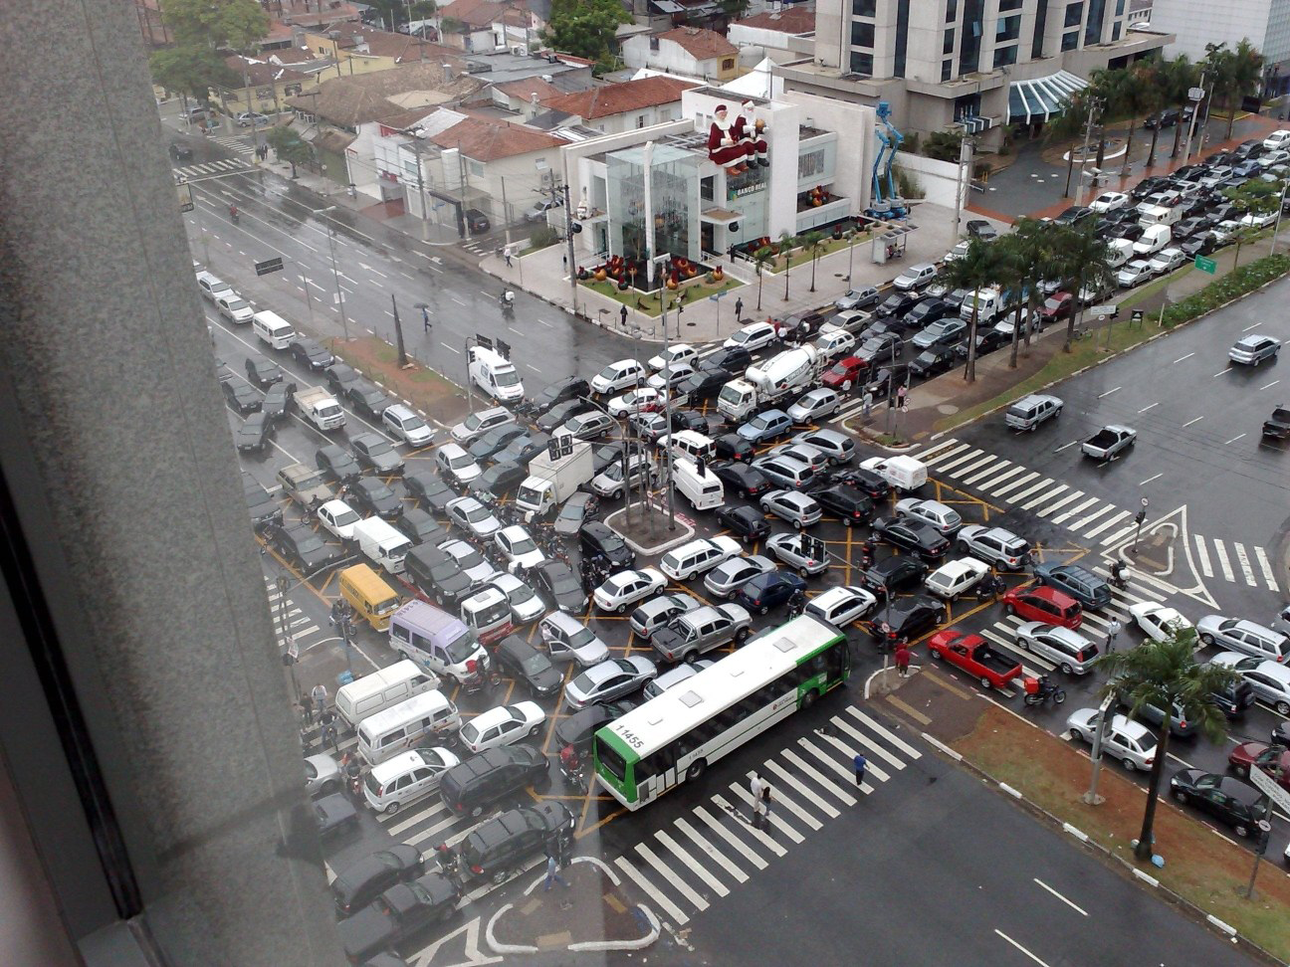
Deadlock

Slide 16
Asynchronous functions
Return immediately. Success or failure will be determined somehow in the future.

Slide 17
Turn
A turn is started by an external event, such as the delivery of a message, completion of an asynchronous request, a user action, or the ticking of the clock.
A callback function associated with the event is called. It runs to completion. When it returns, the turn ends.
No need for threads. No races. No deadlocks.

Slide 18
The Law of Turns
Never block.
Never wait.
Finish fast.

Slide 19
Event Loop
Pro
Con
Completely free of races and deadlocks.
Only one stack.
Very low overhead.
Resilient. If a turn fails, the program can still go on.
Programs must never block.
Turns must finish quickly.
Programs are inside out! Waa!

Slide 20
Event driven systems
Turn based. No pre-emption.
Associate events with actions.
Easy (beginners can do it).
User interfaces.

Slide 21
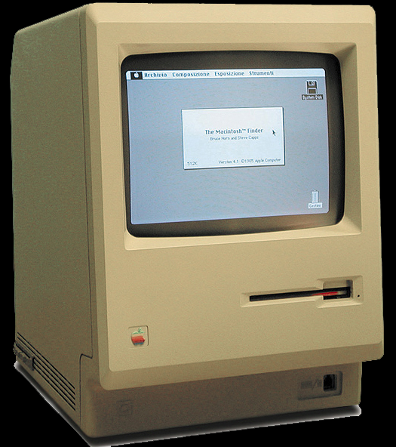

Slide 22
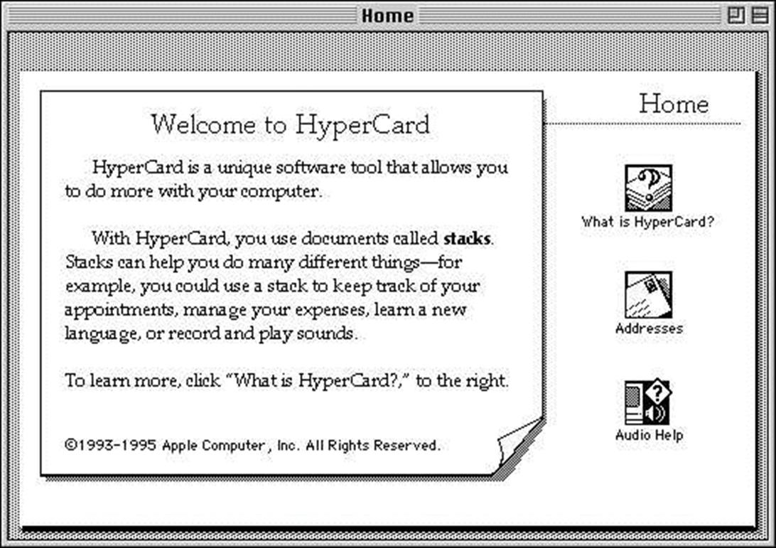
Notes:
Multi-plane b/w bitmap editor with a scripting language.
Non-programmers were amazingly productive with it.

Slide 23
JavaScript is moving to the server.
What servers do is quite different from what browsers do.

Slide 24
node.js
node.js implements a web server in a JavaScript event loop.
It is a high-performance event pump.
fs.readFile(filename, encoding, function (err, data) {...})
Everything is (or can be) non-blocking.
Except:
some synchronous functions
require

Slide 25
Servers
Message driven, message queue
Actor-like
Simple events don’t fit:
Sequential
A sequence of requests, each dependent on the result of the previous.
Naïve approach: deeply nested callbacks
Parallel
Do a bunch of independent things
Naïve approach: wastes time, increases latency
Limited time, cancellation

Slide 26
Functional Programming to the Rescue
Futures
Dataflow and LISP
Promise
Monads
Arrows
RX
FRP: Flapjax, bacon.js, elm.

Slide 27
RQ
A JavaScript library for managing asynchronicity in server applications.

Slide 28
Four or five methods
RQ.sequence(requestors)
RQ.parallel(requestors)
RQ.parallel(requireds, optionals)
RQ.race(requestors)
RQ.fallback(requestors)

Slide 29
RQ.sequence
Takes an array of requestor functions, calls them one at a time, passing the result of the previous requestor to the next requestor.
getNav = RQ.sequence([
read_file(filename),
getPreference,
getCustomNav
]);

Slide 30
RQ.parallel
Takes an array of requestor functions, calls them all at once, and gives an array of results.
getStuff = RQ.parallel([
getNav,
getAds,
getMessageOfTheDay
]);

Slide 31
RQ.parallel
Also takes an optional array of optional requestors. Their results will be included if they can be obtained before the required requestors finish.
getStuff = RQ.parallel([
getNav,
getAds,
getMessageOfTheDay
], [
getHoroscope,
getGossip
]);

Slide 32
RQ.race
Takes an array of requestors, calls them all at once, and gives the result of the first success.
getAds = RQ.race([
getAd(adnet.klikHaus),
getAd(adnet.inUFace),
getAd(adnet.trackPipe)
]);

Slide 33
RQ.fallback
Takes an array of requestors, and gives the result of the first success.
getWeather = RQ.fallback([
fetch("weather", localCache),
fetch("weather", localDB),
fetch("weather", remoteDB)
]);

Slide 34
RQ
All at once
One at a time
All
parallel
sequence
One
race
fallback

Slide 35
RQ.parallel([
RQ.sequence([
widget('Seq A1'),
widget('Seq A2'),
widget('Seq A3')
]),
RQ.sequence([
widget('Seq B1'),
widget('Seq B2'),
widget('Seq B3')
]),
widget('C'),
RQ.race([
widget('Race D1'),
widget('Race D2'),
widget('Race D3')
]),
RQ.fallback([
widget('Fall E1'),
widget('Fall E2'),
widget('Fall E3')
])
], [
RQ.sequence([
widget('Opt Seq O1'),
widget('Opt Seq O2'),
widget('Opt Seq O3')
]),
RQ.sequence([
widget('Opt Seq P1'),
widget('Opt Seq P2'),
widget('Opt Seq P3')
]),
widget('Opt Q'),
RQ.race([
widget('Opt Race R1'),
widget('Opt Race R2'),
widget('Opt Race R3')
]),
RQ.fallback([
widget('Opt Fall S1'),
widget('Opt Fall S2'),
widget('Opt Fall S3')
])
])(show);

Slide 36
RQ.sequence([
widget('Seq S1'),
RQ.parallel([
widget('Par P1'),
widget('Par P2'),
widget('Par P3'),
]),
widget('Seq S3')
])

Slide 37
RQ.sequence([
function (callback) {
fs.readFile('./' + filename + '.cyc', function (error, data) {
if (error) {
console.log(error);
return callback(undefined, error);
}
return callback(data.toString());
});
},
function (callback, value) {
return include(callback, value, get_inclusion);
},
function (callback, value) {
return callback(cyc(value, onehtml));
},
function (callback, value) {
fs.writeFile('./' + filename + '.html', value, function
(error) {
if (error) {
console.log(error);
return callback(undefined, error);
}
return callback(true);
});
}
])(console.log);

Slide 38
RQ requestories with timeouts
RQ.sequence(requestors, milliseconds)
RQ.parallel(requestors, milliseconds)
RQ.parallel(requireds, milliseconds, optionals, untilliseconds)
RQ.race(requestors, milliseconds)
RQ.fallback(requestors, milliseconds)

Slide 39
Cancellation
Any requestor can optionally return a cancel function.
A cancel function, when called, will attempt to cancel a request.
There is no guarantee that the cancellation will happen before the request completes.
Cancellation is intended to stop unnecessary work. It does not undo.

Slide 40
RQ Types
requestor
A function that can execute a request.
callback
A continuation function that will be passed to a requestor.
factory
A function that takes arguments and returns a requestor function.
cancel
A function returned by a requestor that may be used to cancel a request.

Slide 41
RQ Types
requestory(arguments…) →
requestor(
callback(success, failure),
value
) → cancel(reason)

Slide 42
RQ Types
requestory(arguments…) →
requestor(
callback(success, failure),
value
) → cancel(reason)

Slide 43
RQ Types
requestory(arguments…) →
requestor(
callback(success, failure),
value
) → cancel(reason)

Slide 44
RQ Types
factory(arguments…) →
requestor(
callback(success, failure),
value
) → cancel(reason)

Slide 45
Identity Requestor
function identity_requestor(
callback,
value
) {
return callback(value);
}

Slide 46
Fullname Requestor
function fullname_requestor(
callback,
value
) {
return callback(
value.firstname
+ ' ' + value.lastname
);
}

Slide 47
Wrapper Factory
function requestorize(func) {
return function requestor(callback, value) {
return callback(func(value));
};
}
var fullname_requestor = requestorize(
function (value) {
return value.firstname + ' '
+ value.lastname;
}
);

Slide 48
Delay Requestor
function delay(milliseconds) {
function delay_requestor(callback, value) {
var timeout_id = setTimeout(function () {
return callback(value);
}, 1000);
return function cancel(reason) {
return clearTimeout(timeout_id);
};
};

Slide 49
Delay Factory
function delay(milliseconds) {
return function requestor(callback, value) {
var timeout_id = setTimeout(
function () {
return callback(value);
},
milliseconds
);
return function cancel(reason) {
return clearTimeout(timeout_id);
};
};
}

Slide 50
Read File Factory
function read_file(filename, encoding) {
return function requestor(callback, value) {
return fs.readFile(
filename,
encoding || 'utf-8', function (err, data) {
return callback(
data,
err && undefined
);
}
);
};
}

Slide 51
function widget(name) {
return function requestor(requestion, value) {
var result = value ? value + '>' + name : name,
demo = document.getElementById("demo"),
fieldset = document.createElement("fieldset"),
legend = document.createElement("legend"),
success = document.createElement("input"),
failure = document.createElement("input");
fieldset.appendChild(legend);
fieldset.appendChild(success);
fieldset.appendChild(failure);
legend.appendChild(document.createTextNode(name));
success.type = "button";
success.value = "success";
success.addEventListener("click", function () {
fieldset.style.backgroundColor = "lightgreen";
return requestion(result);
}, false);
failure.type = "button";
failure.value = "failure";
failure.addEventListener("click", function () {
fieldset.style.backgroundColor = "pink";
return requestion(undefined, result);
}, false);
demo.appendChild(fieldset);
return function cancel() {
fieldset.style.backgroundColor = "darkgray";
};
};
}

Slide 52
function widget(name) {
return function requestor(requestion, value) {
var result = value ? value + '>' + name : name,
demo = document.getElementById("demo"),
fieldset = document.createElement("fieldset"),
legend = document.createElement("legend"),
success = document.createElement("input"),
failure = document.createElement("input");
fieldset.appendChild(legend);
fieldset.appendChild(success);
fieldset.appendChild(failure);
legend.appendChild(document.createTextNode(name));
success.type = "button";
success.value = "success";
success.addEventListener("click", function () {
fieldset.style.backgroundColor = "lightgreen";
return requestion(result);
}, false);
failure.type = "button";
failure.value = "failure";
failure.addEventListener("click", function () {
fieldset.style.backgroundColor = "pink";
return requestion(undefined, result);
}, false);
demo.appendChild(fieldset);
return function cancel() {
fieldset.style.backgroundColor = "darkgray ";
};
};
}
success.addEventListener("click", function () {
fieldset.style.backgroundColor =
"lightgreen";
return requestion(result);
}, false);

Slide 53
function widget(name) {
return function requestor(requestion, value) {
var result = value ? value + '>' + name : name,
demo = document.getElementById("demo"),
fieldset = document.createElement("fieldset"),
legend = document.createElement("legend"),
success = document.createElement("input"),
failure = document.createElement("input");
fieldset.appendChild(legend);
fieldset.appendChild(success);
fieldset.appendChild(failure);
legend.appendChild(document.createTextNode(name));
success.type = "button";
success.value = "success";
success.addEventListener("click", function () {
fieldset.style.backgroundColor = "lightgreen";
return requestion(result);
}, false);
failure.type = "button";
failure.value = "failure";
failure.addEventListener("click", function () {
fieldset.style.backgroundColor = "pink";
return requestion(undefined, result);
}, false);
demo.appendChild(fieldset);
return function cancel () {
fieldset.style.backgroundColor = "darkgray ";
};
};
}
failure.addEventListener("click", function () {
fieldset.style.backgroundColor = "pink";
return requestion(undefined, result);
}, false);

Slide 54
function widget(name) {
return function requestor(requestion, value) {
var result = value ? value + '>' + name : name,
demo = document.getElementById("demo"),
fieldset = document.createElement("fieldset"),
legend = document.createElement("legend"),
success = document.createElement("input"),
failure = document.createElement("input");
fieldset.appendChild(legend);
fieldset.appendChild(success);
fieldset.appendChild(failure);
legend.appendChild(document.createTextNode(name));
success.type = "button";
success.value = "success";
success.addEventListener("click", function () {
fieldset.style.backgroundColor = "lightgreen";
return requestion(result);
}, false);
failure.type = "button";
failure.value = "failure";
failure.addEventListener("click", function () {
fieldset.style.backgroundColor = "pink";
return requestion(undefined, result);
}, false);
demo.appendChild(fieldset);
return function cancel() {
fieldset.style.backgroundColor = "darkgray ";
};
};
}
return function cancel() {
fieldset.style.backgroundColor = "darkgray";
};

Slide 55
Testing
assertEquals(message, expected, actual)
does not work

Slide 56
QuickCheck
Koen Claessen
John Hughes
Chalmers University

Slide 57
JSCheck
Case generation
Testing over turns
JSC.claim(name, predicate, signature)
JSC.check(milliseconds)
JSC.on_report(callback)
JSC.on_error(callback)

Slide 58
JSC.claim(name, predicate, signature)
name is a string
function predicate(verdict, et al…)
signature is an array of specifications, one per et al…
JSC.claim(
"Compare the old code with the new code", function predicate(verdict, a) { verdict(oldCode(a) === newCode(a)); }, [JSC.integer()] );

Slide 59
Specifiers
JSC.any()
JSC.array()
JSC.boolean() JSC.character()
JSC.falsy()
JSC.integer()
JSC.literal()
JSC.number()
JSC.object()
JSC.one_of()
JSC.sequence()
JSC.string()

Slide 60
JSC.string(
3, JSC.character('0', '9'),
1, '-',
2, JSC.character('0', '9'),
1, '-',
4, JSC.character('0', '9')
)
"094-55-0695"
"571-63-9387"
"130-08-5751"
"296-55-3384"
"976-55-3359"

Slide 61
JSC.array([
JSC.integer(),
JSC.number(100),
JSC.string(8, JSC.character('A', 'Z'))
])
[3, 21.228644298389554, "TJFJPLQA"]
[5, 57.05485427752137, "CWQDVXWY"]
[7, 91.98980208020657, "QVMGNVXK"]
[11, 87.07735128700733, "GXBSVLKJ"]

Slide 62
JSC.object({
left: JSC.integer(640),
top: JSC.integer(480),
color: JSC.one_of([
"black", "white", "red",
"blue", "green", "gray"
])
})
{"left":104, "top":139, "color":"gray"}
{"left":62, "top":96, "color":"white"}
{"left":501, "top":164, "color":"red"}
{"left":584, "top":85, "color":"white"}

Slide 63
JSC.object(
JSC.array(
JSC.integer(3, 8),
JSC.string(4, JSC.character('a', 'z'))
),
JSC.boolean()
)
{"jodo":true, "zhzm":false, "rcqz":true}
{"odcr":true, "azax":true, "bnfx":true,
"hmmc":false}
{"wjew":true, "kgqj":true, "abid":true,
"cjva":false, "qsgj":true, "wtsu":true}
{"qtbo":false, "vqzc":false, "zpij":true,
"ogss":false, "lxnp":false, "psso":true,
"irha":true, "ghnj":true}

Slide 64
verdict
When check calls a predicate, it passes in a verdict function.
Predicates deliver the result of each trial by calling the verdict function.
verdict is a continuation, allowing trials to extend over many turns.
Three outcomes:
pass fail lost

Slide 65
Closure and continuation.

Slide 66
https://github.com/douglascrockford/RQ https://github.com/douglascrockford/JSCheck

